Slide 1
The application of Internet of Things in smart home
——Pet intelligent management platform
Bo Tong
Notes:
Good evening everyone, my name is tongbo, I am doing a smart home application in pet management.
In our daily life, many people like to keep pets. Pets can bring us joy. In the busy study life, the company of pets can ease the stress of our daily life. However, many times we work very busy. There is no way to take care of our pets in time, so I think it is a very necessary thing to design a remote pet management platform.
With this platform, we can keep abreast of the basic situation of pets, feed pets through the platform, and when our pets are lost, we can also easily find our pets.
Through a platform, we can integrate many ways to manage pets and free up our time. When we want to know our pet partners, we can open a platform and we can easily get a lot of information about pets.

Slide 2



——Pet intelligent management platform
Dilemma：
work
study
travel
In short, you can't stay with your pet at home all the time ！
Notes:
Practical innovation
On IOT smart home
A website that show the condition of our pet, we can monitor our pet through this website.
Then we can feed pet using this platform
Target our pet’s location
Surveillance cameras

Slide 3


——Pet intelligent management platform
Notes:
To do this, we deployed sensors through the Raspberry Pi and built a website on my laptop with Django

Slide 4
——Pet intelligent management platform
There are five parts:
1.get some basic real-time data of the pet
2. Video Surveillance
3. feed the food remotely
4. the location
5.Echart graph
Notes:
I use the Raspberry Pi to connect the sensors I need, and then use django to build my web server. The Raspberry Pi sends the data obtained by the sensor to the server for analysis.
Longitude
latitude

Slide 5
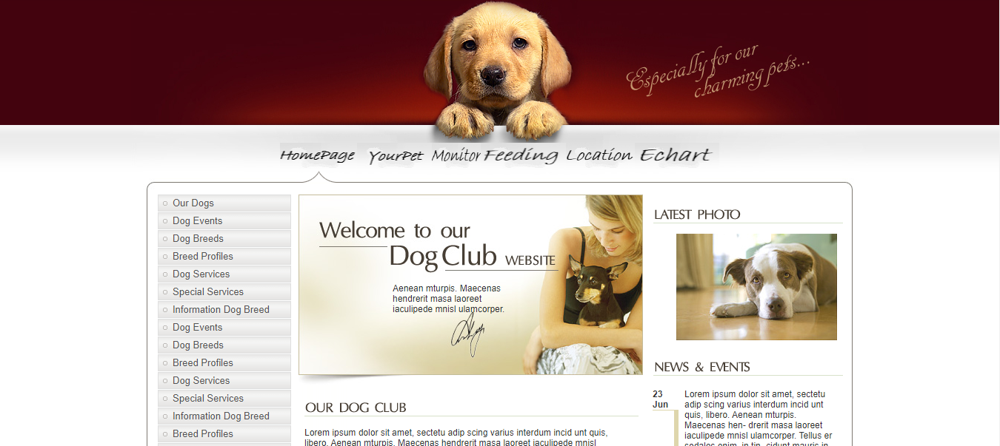
——Pet intelligent management platform
Demo

